Slide 1
Unity / Rocket Golf
By Caleb Carlson, Brandon Neff, and Nathan Spaulding

Slide 2
Downloading Unity
See Dr. Ward’s slides for downloading Unity
MAKE SURE TO DOWNLOAD ANDROID BUILD SUPPORT!!!

Slide 3
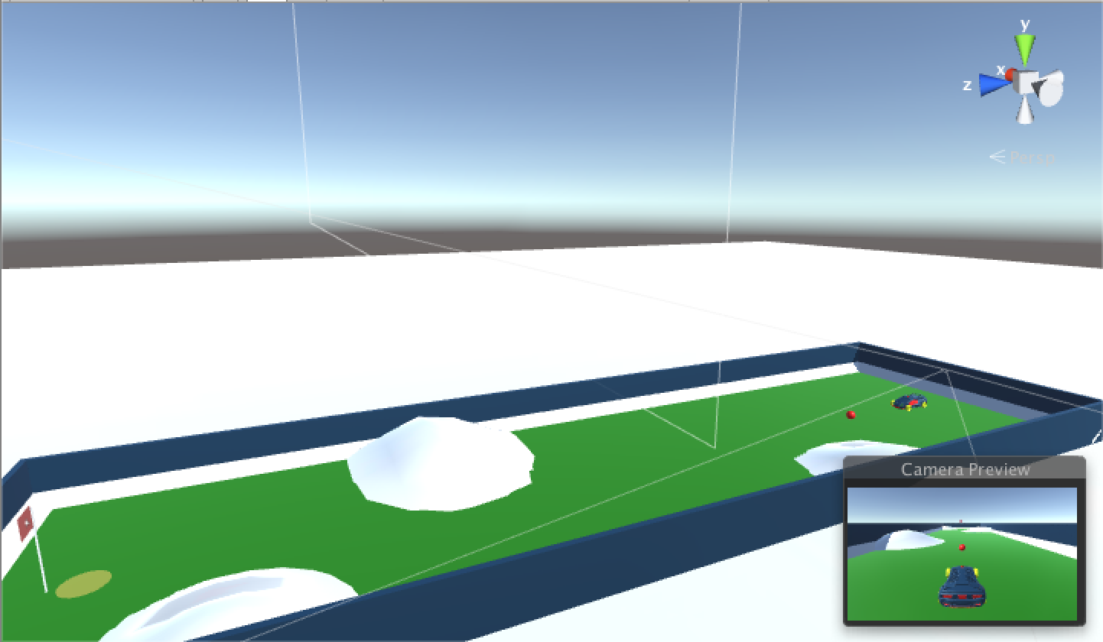
Rocket Golf!!!

Slide 4
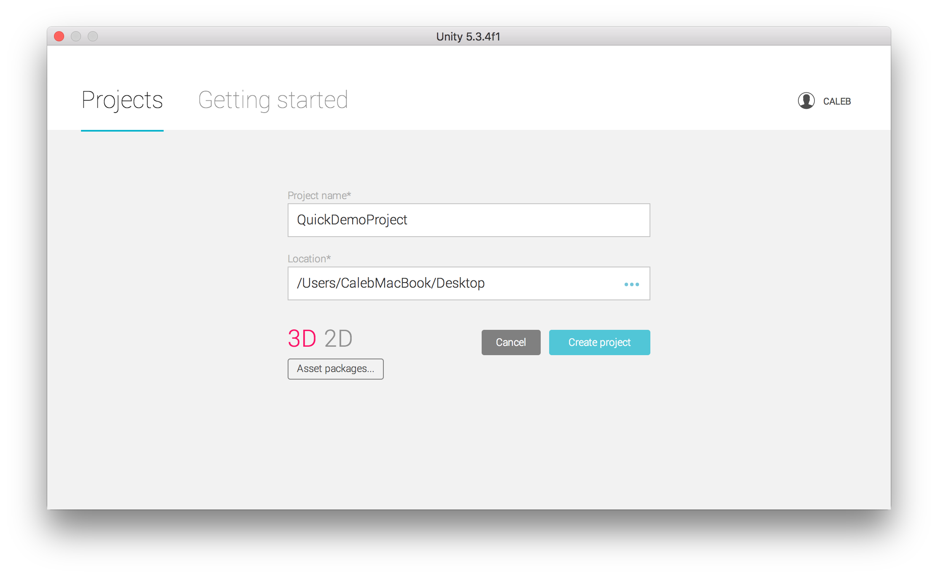
Creating A Project

Slide 5
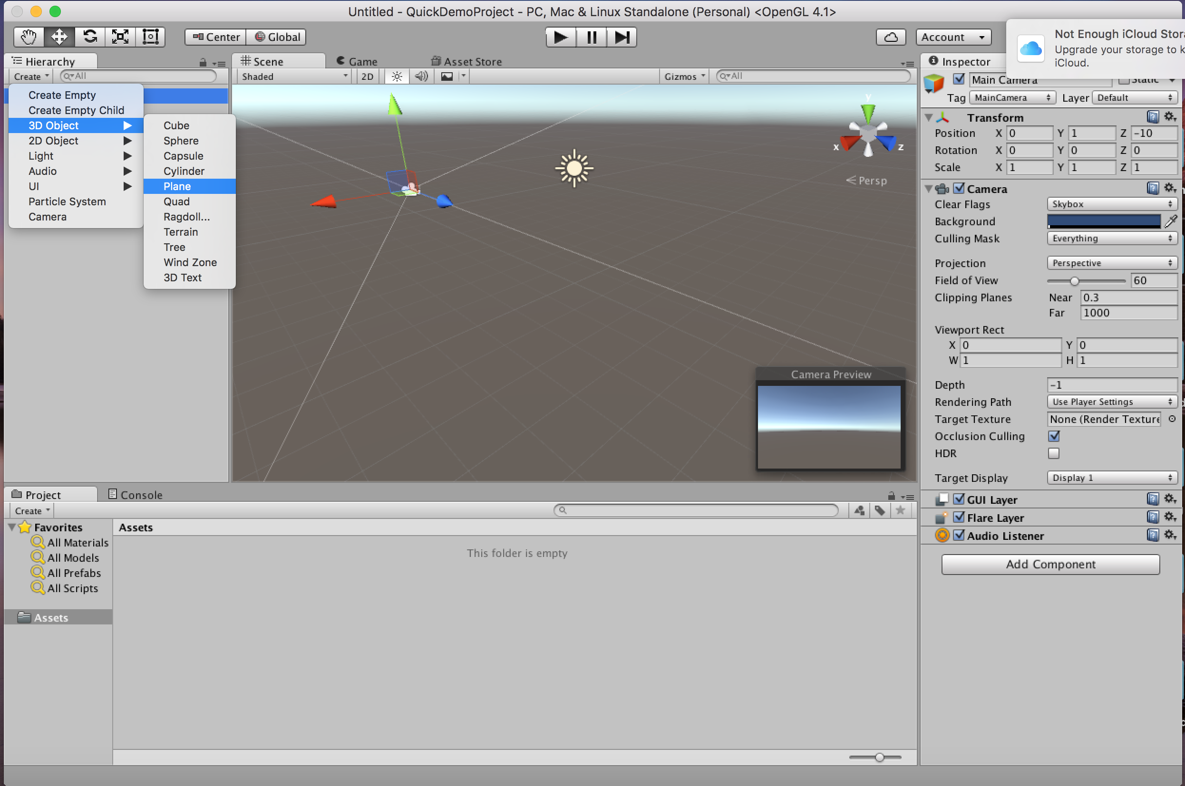
Creating Shapes

Slide 6
The Camera

Slide 7
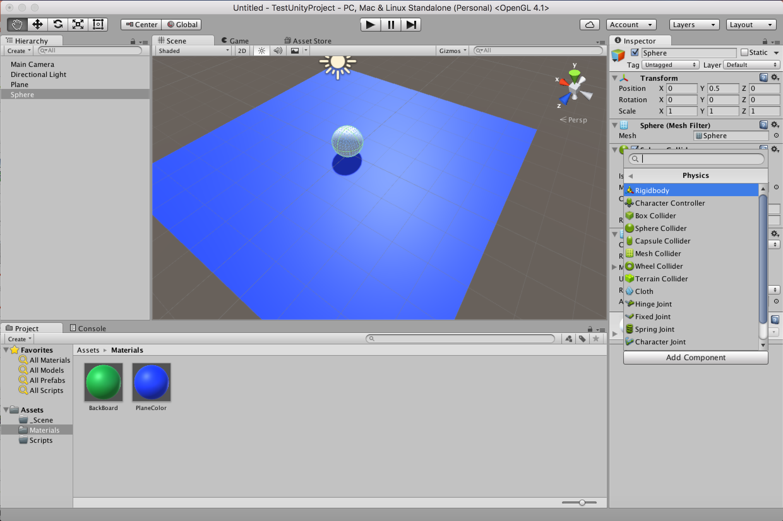
Physics
To get an object to animate you need to add a Rigidbody to you object. This is the basic 3D Physics component to get your object to act to collisions and gravity.

Slide 8
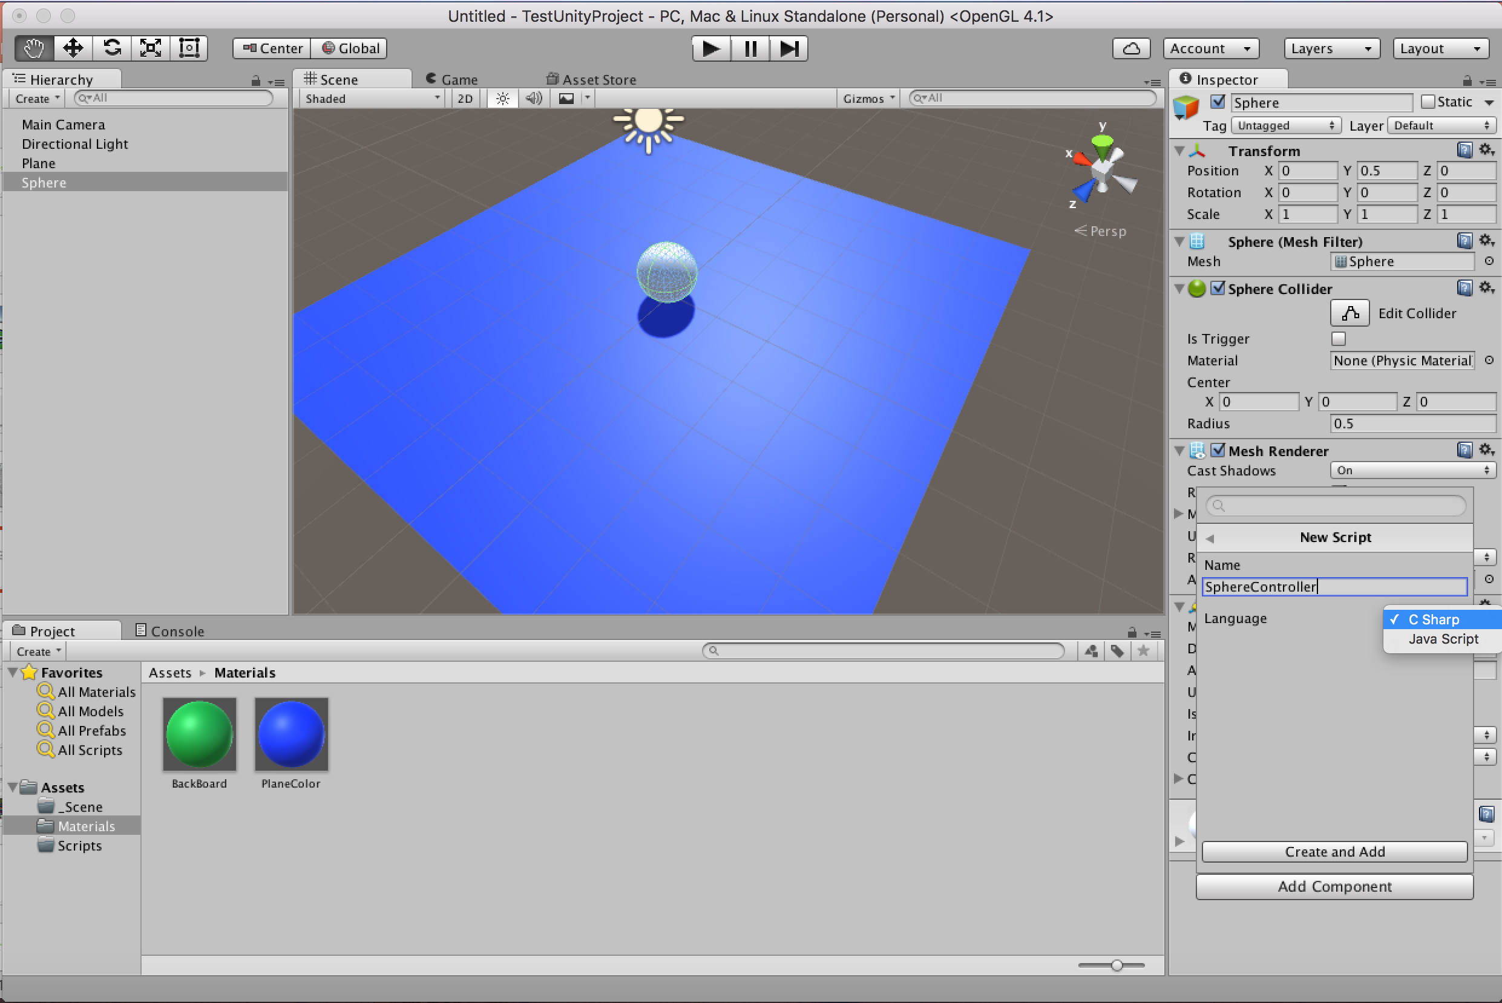
Scripts
Scripts allow you to modify how objects interact with each other beyond the basic collision.

Slide 9
Two Types Of Contact: Collision vs Trigger
Triggers are used when you want to objects to overlap and “collect” each other
Collisions are meant for when objects are going to collide and have physics forces act on each shape

Slide 10
To the project!

Slide 11
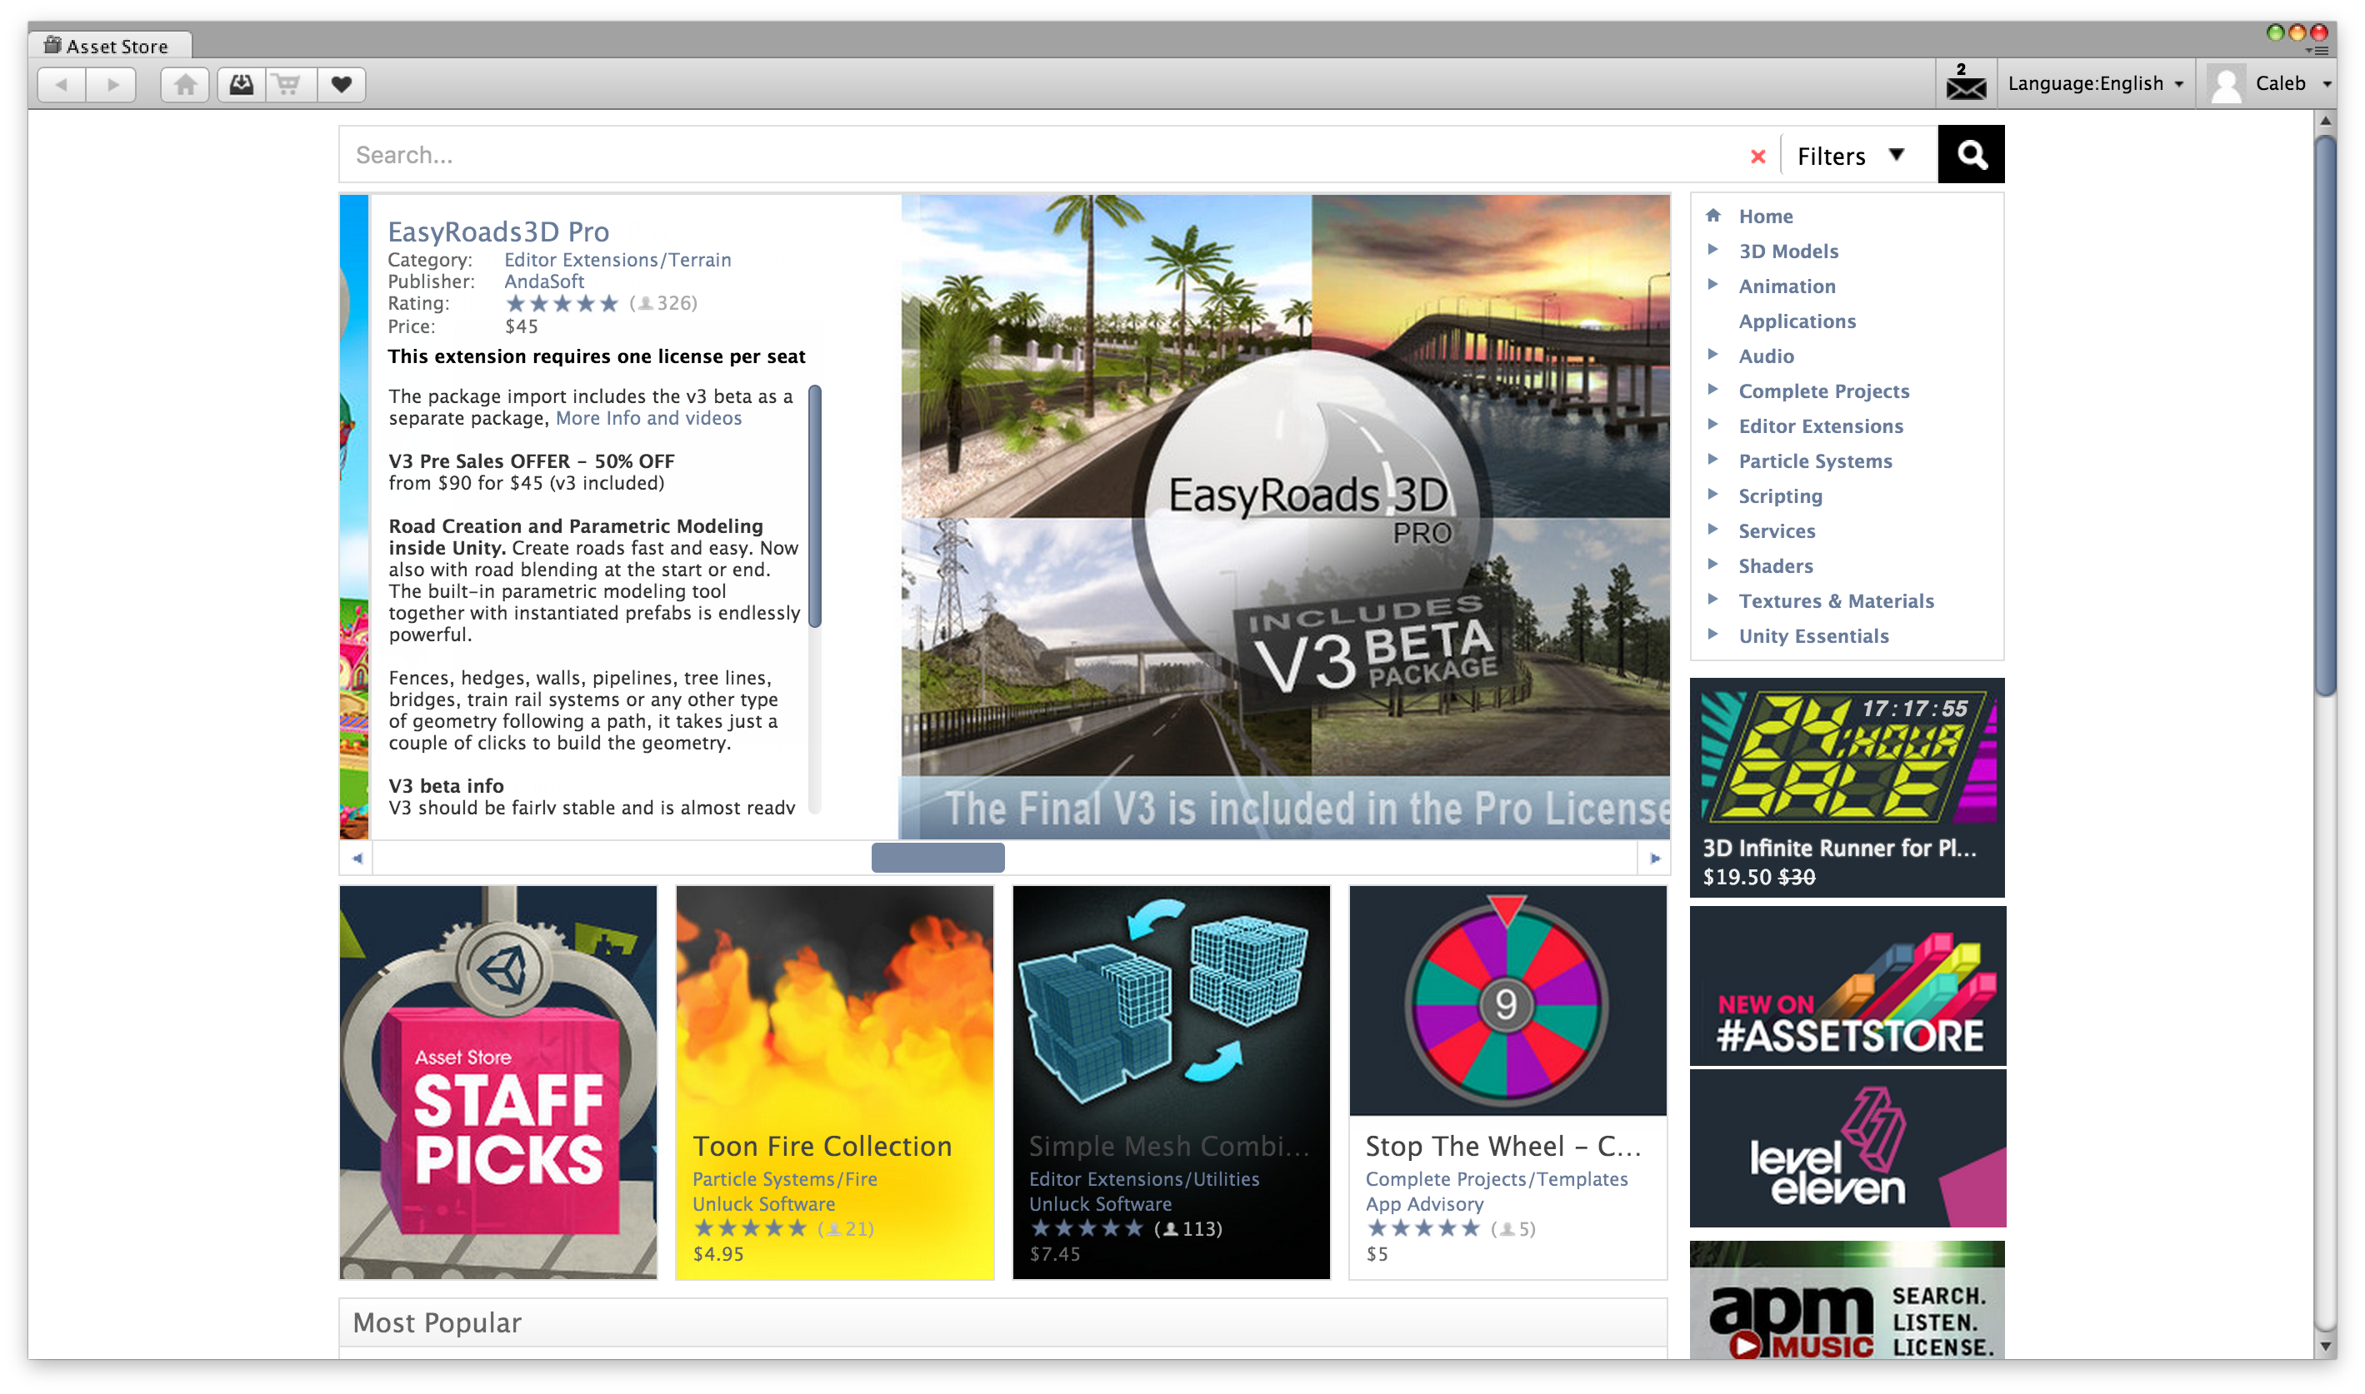
How did we make that awesome car??? We didn’t… Assets Store

Slide 12
Building in Android
Back to the project!

Slide 13
References
http://unity3d.com/learn/tutorials/projects/roll-ball-tutorial (Great tutorial for game basics)
http://docs.unity3d.com/Manual/index.html (Unity Manual)

Slide 14
Play the game that inspired it all….

Slide 15
Q & A

